Slide 1
Graph-Centric Security Applications, Explanation, and Computation
Dr. Yuede Ji, Assistant Professor
Graph Lab @ University of North Texas
Notes:
Thank you for the introduction.
I am super excited to share our research on Graph-Centric Security Applications, Explanation, and Computation.
Before I start, I would like to express my heartful gratitude to Seung-Hwan and Ramki for hosting me and the support from DOE’s VFP program. I really had a wonderful time at ORNL for the past ten weeks. I got the chance to meet many of you, who are very talented researchers working on super exciting projects. Thank you and I wish our career path could cross again in the future!

Slide 2

Graph in Real Applications
Application | Graph | Algorithm | Usage
Navigation
Src
1
Dst
c
1
b
c
1
b
Road map graph
Shortest path
a
f
a
1
1
f
2
d
2
Notes:
So, our research centers on graph.
A graph is made up of vertex and edge. It is a natural data representation for many real-world applications.
For example, in the route map, taking a crossing as a vertex and the road between two crossings as an edge,
we can build a road map graph. With that, the shortest path algorithm can help for navigation. In this example graph, if we wanna go from place a to f,
the shortest path algorithm can help to find this colored path for us.

Slide 3
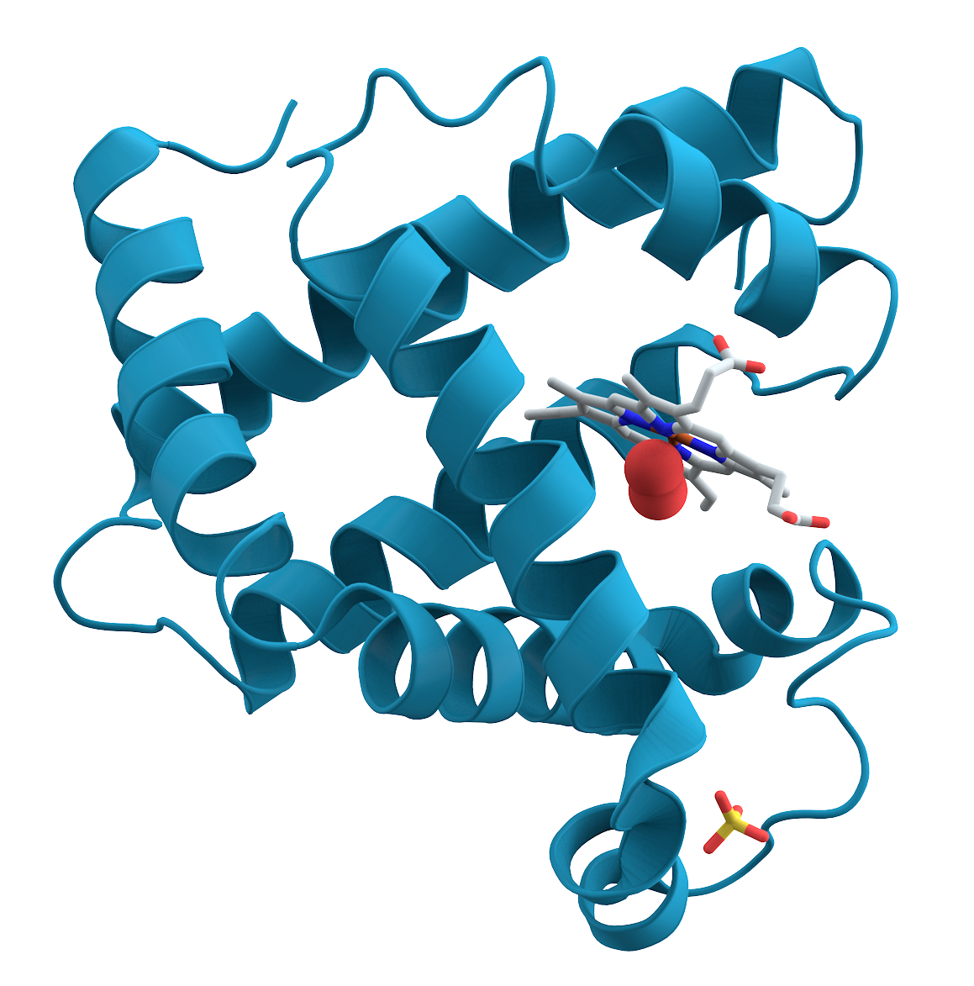
Graph in Real Applications
Application | Graph | Algorithm | Usage
Navigation | Road map graph | Shortest path
Key connector protein identification
Src
1
Dst
c
1
b
c
1
b
a
f
a
1
1
f
2
d
2
a
Key
d
e
Protein-protein interaction graph
Betweenness centrality
c
f
c
b
g
h
Notes:
In protein analysis, the proteins are known to interact with each other to act their functions.
With that, we can build a protein-protein interaction graph.
Using the centrality algorithm, such as betweenness centrality, we can identify the key connector protein.
In this example graph,
protein c would be identified as the key connector protein.

Slide 4

Graph in Real Applications
Application | Graph | Algorithm | Usage
Navigation | Road map graph | Shortest path
Key connector protein identification | Protein-protein interaction graph | Betweenness centrality
Friend recommendation
Src
1
Dst
c
1
b
c
1
b
a
f
a
1
1
f
2
d
2
a
Key
d
e
c
f
c
b
g
h
a
Friendship graph
Triangle completing
c
Mutual friend
Friend?
c
b
Notes:
In social network, we can build a friendship graph.
On this graph, the triangle completing algorithm can help to recommend friends.
In this triangle, users a and b share a mutual friend c. Then it is possible that a and b know each other.

Slide 5

Graph in Real Applications
Application | Graph | Algorithm | Usage
Navigation | Road map graph | Shortest path
Key connector protein identification | Protein-protein interaction graph | Betweenness centrality
Friend recommendation | Friendship graph | Triangle completing
Vulnerability detection
Src
1
Dst
c
1
b
c
1
b
a
f
a
1
1
f
2
d
2
a
Key
d
e
c
f
c
b
g
h
a
c
Mutual friend
Friend?
c
b
Alarm!
h
b
a
b
a
Control flow graph
Subgraph isomorphism
b
c
c
Vulnerability template
e
f
Unknown software
Notes:
In vulnerability detection, the code is usually represented as a control flow graph.
Given an unknown software,
if it matches to a known vulnerability template, then it is possible to have the same vulnerability. This can be done with the help of subgraph isomorphism.
Although the graph algorithms are insightful, three major challenges block them from being easily applied in reality.

Slide 6

Challenge #1: Domain Specific Challenges
Q2: How to formalize the problem with graph?
Q3: What graphs should we build?
Q1: What is the research problem?
!?
…
Q4: Can graph better represent the data?
Q7: Does it work better than conventional solutions?
Q5: What are the properties of these graphs?
Q6: What graph algorithms should we use?
Notes:
The first challenge comes from applying graph to the specific domains.
For an application, we get excited when we think graph can be applied.
Then, the questions come.
Such as
...
Basically, we need to deeply understand the specific domain, instead of blindly building graphs and applying graph algorithms.

Slide 7

Challenge #2: Lacking Explanations for Real Applications
Current graph (especially graph learning)-based solutions do not provide sufficient context information regarding why a prediction is made.
Existing models generate too many alarms to be verified by the security analysts.
E.g., most organizations in US receive 17,000 alerts per week while only 4% of them are properly investigated [FireEye].
Threat alert fatigue problem
It can lead to either the missing of the alarm or the finding comes too late.
Picture source: Palo Alto Networks
Notes:
The second challenge is lacking explanations for real applications. Current graph-based solutions, especially graph learning-based, do not provide sufficient context information regarding why a prediction is made. When such a solution is applied to real applications, it will give a heavy burden to the users.
For example, in cybersecurity applications, existing models generate too many alarms, while the security analysts are not able to verify them. From a report of FireEye, most organizations in US receive 17,000 alters per week while only 4% of them are properly investigated.
This will lead to the Threat alert fatigue problem, which can cause either the missing of the alarm or the finding comes too late.

Slide 8
Challenge #3: Low Computation Efficiency
Graph is big data in terms of both size and count.
Num. of Active users on Facebook
Num. of Graphs in Several Biological and Chemical Dataset
Avg. = 44 K
Total > 1 Million
User count in million
2.7 Billion
Num. of graphs
source: statista
source: TUDatasets
Notes:
The third challenge is the low computation efficiency.
Graph, in reality, is big data in terms of both graph size and count.
This figure shows the number of active users on Facebook from 2008 till 2020. The x-axis shows the year and y-axis shows the user count in million.
We can see the user count which is also the graph size keeps growing and the trend does not show any slowdown.
By 2020, it has reached 2.7 billion.
The figure on the right shows the number of graphs in several biological and chemical dataset.
The x-axis shows each dataset and y-axis shows the number of graphs in each dataset.
The average number of graphs in each dataset is 44 thousand and the total has reached over 1 million.

Slide 9
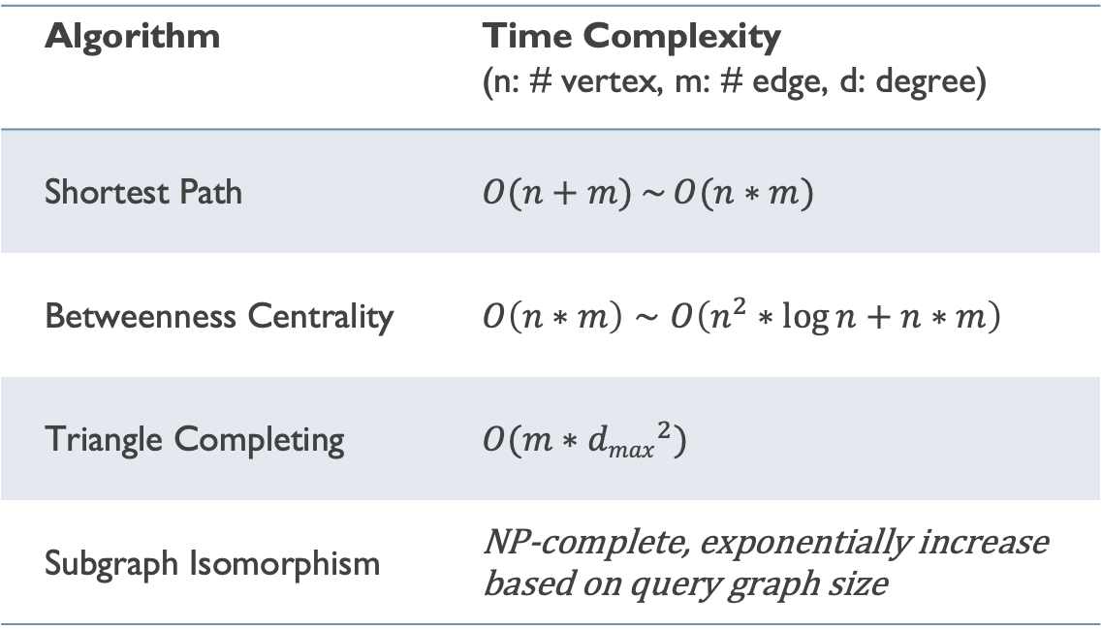
Challenge #3: Low Computation Efficiency
Many graph algorithms have high time complexity.
Algorithm | Time Complexity (n: # vertex, m: # edge, d: degree)
Shortest Path | $O(n+m)$ $\sim$ $O(n∗m)$
Betweenness Centrality | $O\left(n∗m\right)$ $\sim$ $O\left(n^{2}∗\log{n}+n∗m\right)$
Triangle Completing | $$O(m∗{dmax}^{2})$$
Subgraph Isomorphism | NP-complete, exponentially increase based on query graph size
Notes:
Also, many graph algorithms have high time complexity.
This table summarizes the best time complexity of the four graph algorithms used in the previous applications.
For these four algorithms, the time complexity ranges from linear to NP-complete.

Slide 10
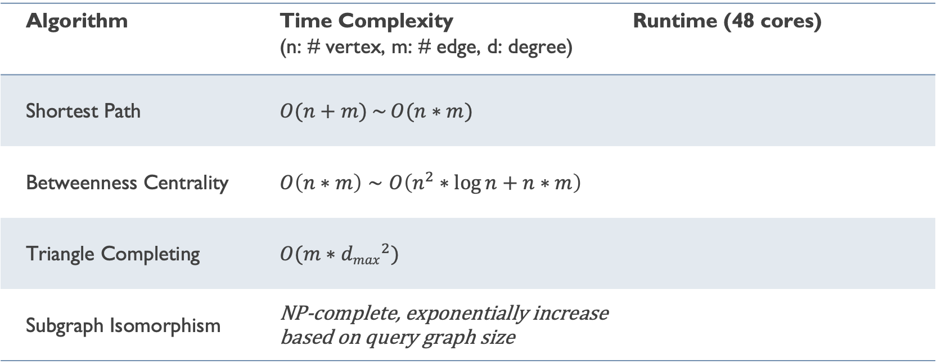
Challenge #3: Low Computation Efficiency
Many graph algorithms have high time complexity.
Friendster:
# of vertex: 68 M
# of edges: 2.6 B
Algorithm | Time Complexity (n: # vertex, m: # edge, d: degree) | Runtime (48 cores)
Shortest Path | $O(n+m)$ $\sim$ $O(n∗m)$
Betweenness Centrality | $O\left(n∗m\right)$ $\sim$ $O\left(n^{2}∗\log{n}+n∗m\right)$
Triangle Completing | $$O(m∗{dmax}^{2})$$
Subgraph Isomorphism | NP-complete, exponentially increase based on query graph size
0.5 second
Ligra [Shun et al. PPoPP’13]: An actively maintained graph system
7 seconds
30 mins
CECI
[Bhattarai et al. SIGMOD’19]
1 hour 10 minutes
(Query: a graph with 6 vertices)
Notes:
Now, let’s look at the real runtime.
I tested a social network graph, Friendster.
It has 68 million vertices and 2.6 billion edges.
The first three algorithms are tested with Ligra, which is an actively maintained graph computation system. It is regarded as one of the state-of-the-art graph computation systems.
With 48 cores, the shortest path algorithm takes only 0.5 second. It’s fast.
The betweenness centrality algorithm takes 7 seconds, not too slow.
But the triangle completing algorithm takes 30 mins, which is slow.
For subgraph isomorphism, I report the runtime of a recent work, CECI, from SIGMOD’19.
For a query graph with only 6 vertices, the algorithm needs to run 1 hour and 10 minutes.
There will be a problem if the real applications take this much time to just run the algorithm.

Slide 11
High-Level View of Applying Graph in Reality
Graph Algorithms
Conventional
Graph Learning
Connected Component,
Shortest Path,
PageRank,
...
Graph Convolution Network,
Graph Attention Network,
Node2vec,
...
Build Domain-Specific Graphs
Post-Processing for Specific Tasks
CPU
CPU
CPU
CPU
CPU
CPU
GPU
Memory
Memory
Memory
Shared-Memory System
Distributed-Memory System
Application
Domains
High-Performance Computing for Graph Algorithms
Domain-Specific
Tasks
Notes:
Let's look at how to apply graph in really from a high level.
It starts from the application domains.
For each domain, we would build domain-specific graphs.
Then, we would select the appropriate graph algorithms, including the conventional graph algorithms, such as connected component, shortest path, and pagerank.
Also, many graph-based machine learning algorithms are proposed recently, such as graph convolution network, graph attention network, and node2vec.
To accelerate the computation, we would use different high-performance computing hardware, such as shared-memory system, distributed-memory system, and GPUs.
Later, with the graph computation result, we need to postprocess it and map to the corresponding task.
In the past study, we tried to address the previously discussed challenges from two directions.
The first one is end-to-end, we deeply studied how to apply graph to one application domain, cybersecurity.
The other one is vertical. We build High-Performance Computing systems for Graph Algorithms.

Slide 12
Research #1: Applying Graph to Security Applications
Research Questions:
Q1: How to correctly formalize the cybersecurity problem to a graph problem?
Q2: How to effectively solve the graph problem?
Domain | Project | Graph | Graph Algorithms
Code Vulnerability Detection | DEFInit [USENIX Security ’21] | Dependency + Control Flow Graph | Graph Traversal
 | BugGraph [AsiaCCS ’21] | Control Flow Graph | Graph Triplet-Loss Network
 | Vestige [ACNS ’21] | Function Call Graph | Graph Attention Network
NSF OAC CICI: UCSS: Secure Containers in High-Performance Computing Infrastructure (PI, $600k)
Notes:
We try to apply graph techniques to various cybersecurity applications. To achieve that, we aim to answer two research questions.
The first one is How to correctly formalize the cybersecurity problem to a graph problem?
The second one is How to effectively solve the graph problem?
With that, we deeply studied the code vulnerability detection problem. We have built three systems with graph and graph algorithms.
The first one is DEFInit, it scans Android firmware and identifies potential vulnerabilities related to system services. We built dependency graph and control flow graph.
The second one is BugGraph, it detects binary code vulnerability by building control flow graphs and applying graph triplet-loss network.
The third one is Vestige, it identifies binary code compilation provenance by building function call graph and applying graph attention network.
In he meantime, I would like to share a good news, in this summer while I am here, we received an NSF grant to support our study on the security of containers in the HPC Infrastructures.

Slide 13
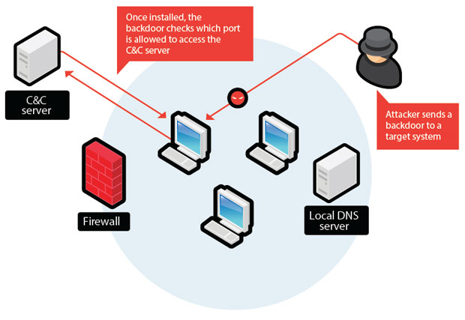
Research #1: Applying Graph to Security Applications
Research Questions:
Q1: How to correctly formalize the cybersecurity problem to a graph problem?
Q2: How to effectively solve the graph problem?
Domain | Project | Graph | Graph Algorithms
Code Vulnerability Detection | DEFInit [USENIX Security ’21] | Dependency + Control Flow Graph | Graph Traversal
 | BugGraph [AsiaCCS ’21] | Control Flow Graph | Graph Triplet-Loss Network
 | Vestige [ACNS ’21] | Function Call Graph | Graph Attention Network
Network Threat Detection | Malware Detection [ISSTA ’23] | API Graph | Heuristic Random Walk Node Embedding
 | Lateral Movement Detection [RAID ’20] | Authentication Graph | Unsupervised Node Embedding
 | Malicious URL Detection [NPC ’14 Best Paper Award] | Social Network User Graph | Local Clustering Coefficient
Reported to DARPA CHASE program
BugGraph
Vestige
Lateral movement detection
NSF OAC CICI: UCSS: Secure Containers in High-Performance Computing Infrastructure (PI, $600k)
Notes:
Also, we have applied graph algorithms to network threat detection. So far, we have studied malware detection with API graph, lateral movement detection with authentication graph, and malicious URL detection in social network.
Several projects have been reported to the DARPA CHASE (Cyber Hunting At ScalE) program.
In the following, I will deeply explain our efforts on code vulnerability detection by discussing BugGraph.

Slide 14
Research #2: Explanation for Security Applications
Research Questions:
Q1: How to reasonably explain graph neural networks (GNNs) for specific security applications?
Q2: How to efficiently compute the explanation methods?
Application | Project | Expected Explanation Outcome | Targeted Users
Code Vulnerability Detection | Illuminati [EuroS&P ’22] | The subgraph along with features that lead to the vulnerability. | Security analysts
The pre-trained GNN model to be explained
DOE VFP Program: Efficient Computation for Graph Neural Network Explanation Methods on GPUs
Notes:
Following the study of applying graph to security applications, we realize they lack explanations. Motivated by that, we aim to study the Explanation for Security Applications.
In particular, we aim to answer two research questions.
The first one is how to reasonably explain graph neural networks (GNNs) for specific security applications?
The second is How to efficiently compute the explanation methods?
In the following, I will deeply explain this by discussing our work, Illuminati.
Also, I would like to thank again to the DOE VFP program for supporting our research in this direction.

Slide 15
Research #3: HPC Systems for Graph Algorithms
Research Questions:
Q1: How to efficiently compute conventional graph algorithms?
Q2: How to efficiently compute graph neural network algorithms?
Conventional Graph Algorithm
Peek: Top-k shortest path [SC ’23]
iSpan: Strongly connected [SC ’18]
Aquila: Connectivity [HPDC ’20]
Graph Neural Network (GNN)
Tango [SC ’23]
TLPGNN [HPDC ’22]
CPU
CPU
CPU
CPU
CPU
CPU
GPU
Memory
Memory
Memory
Shared-Memory System
Distributed-Memory System
High-Performance Computing for Graph Algorithms
NSF CISE Small Core Collaborative: LEGAS: Learning Evolving Graphs At Scale (Lead-PI, $600k)
Notes:
In the third direction, we aim to design HPC systems for graph algorithms.
We aim to answer two research questions here.
The first one is How to efficiently compute conventional graph algorithms.
With that, we have developed Peek for top-k shortest path algorithm, iSpan for strongly connected component, and Aquila for multiple connectivity algorithms.
The second question is How to efficiently compute graph neural network algorithms?
Following that, we have developed Tango and TLPGNN.
In the following, I would present the details of TLPGNN. I wish to present one of our SC papers accepted this year, but our slides are not ready. If you are interested, maybe I can present them next time.
In the meantime, I would like to share another good news. Also, in this summer while I am here, we received another NSF grant to support our study on improving the computation efficiency of GNNs, especially on evolving graphs.

Slide 16
Graph Lab @ UNT
Security
Code vulnerability detection
DEFInit [Security ’21]
BugGraph [AsiaCCS ’21]
Vestige [ACNS ’21]
Cyber threat detection
API2Vec [ISSTA ’23]
NestedGNN [ICC ’22]
CyberGraph [RAID ’20]
High-Performance Computing (HPC)
Graph Algorithm/AI
HPC for graph algorithms
PeeK [SC’ 23]
Aquila [HPDC ’20]
iSpan [SC ’18]
Graph AI explanation
Illuminati [EuroS&P ’22]
HPC for graph AI
Tango [SC ’23]
TLPGNN [HPDC ’22]
Notes:
In summary, our group takes graph as the centric and works on security, graph algorithms, and HPC.
In particular, we are working on Code vulnerability detection, Cyber threat detection, Graph AI explanation, HPC for graph AI, and HPC for graph algorithms.

Slide 17
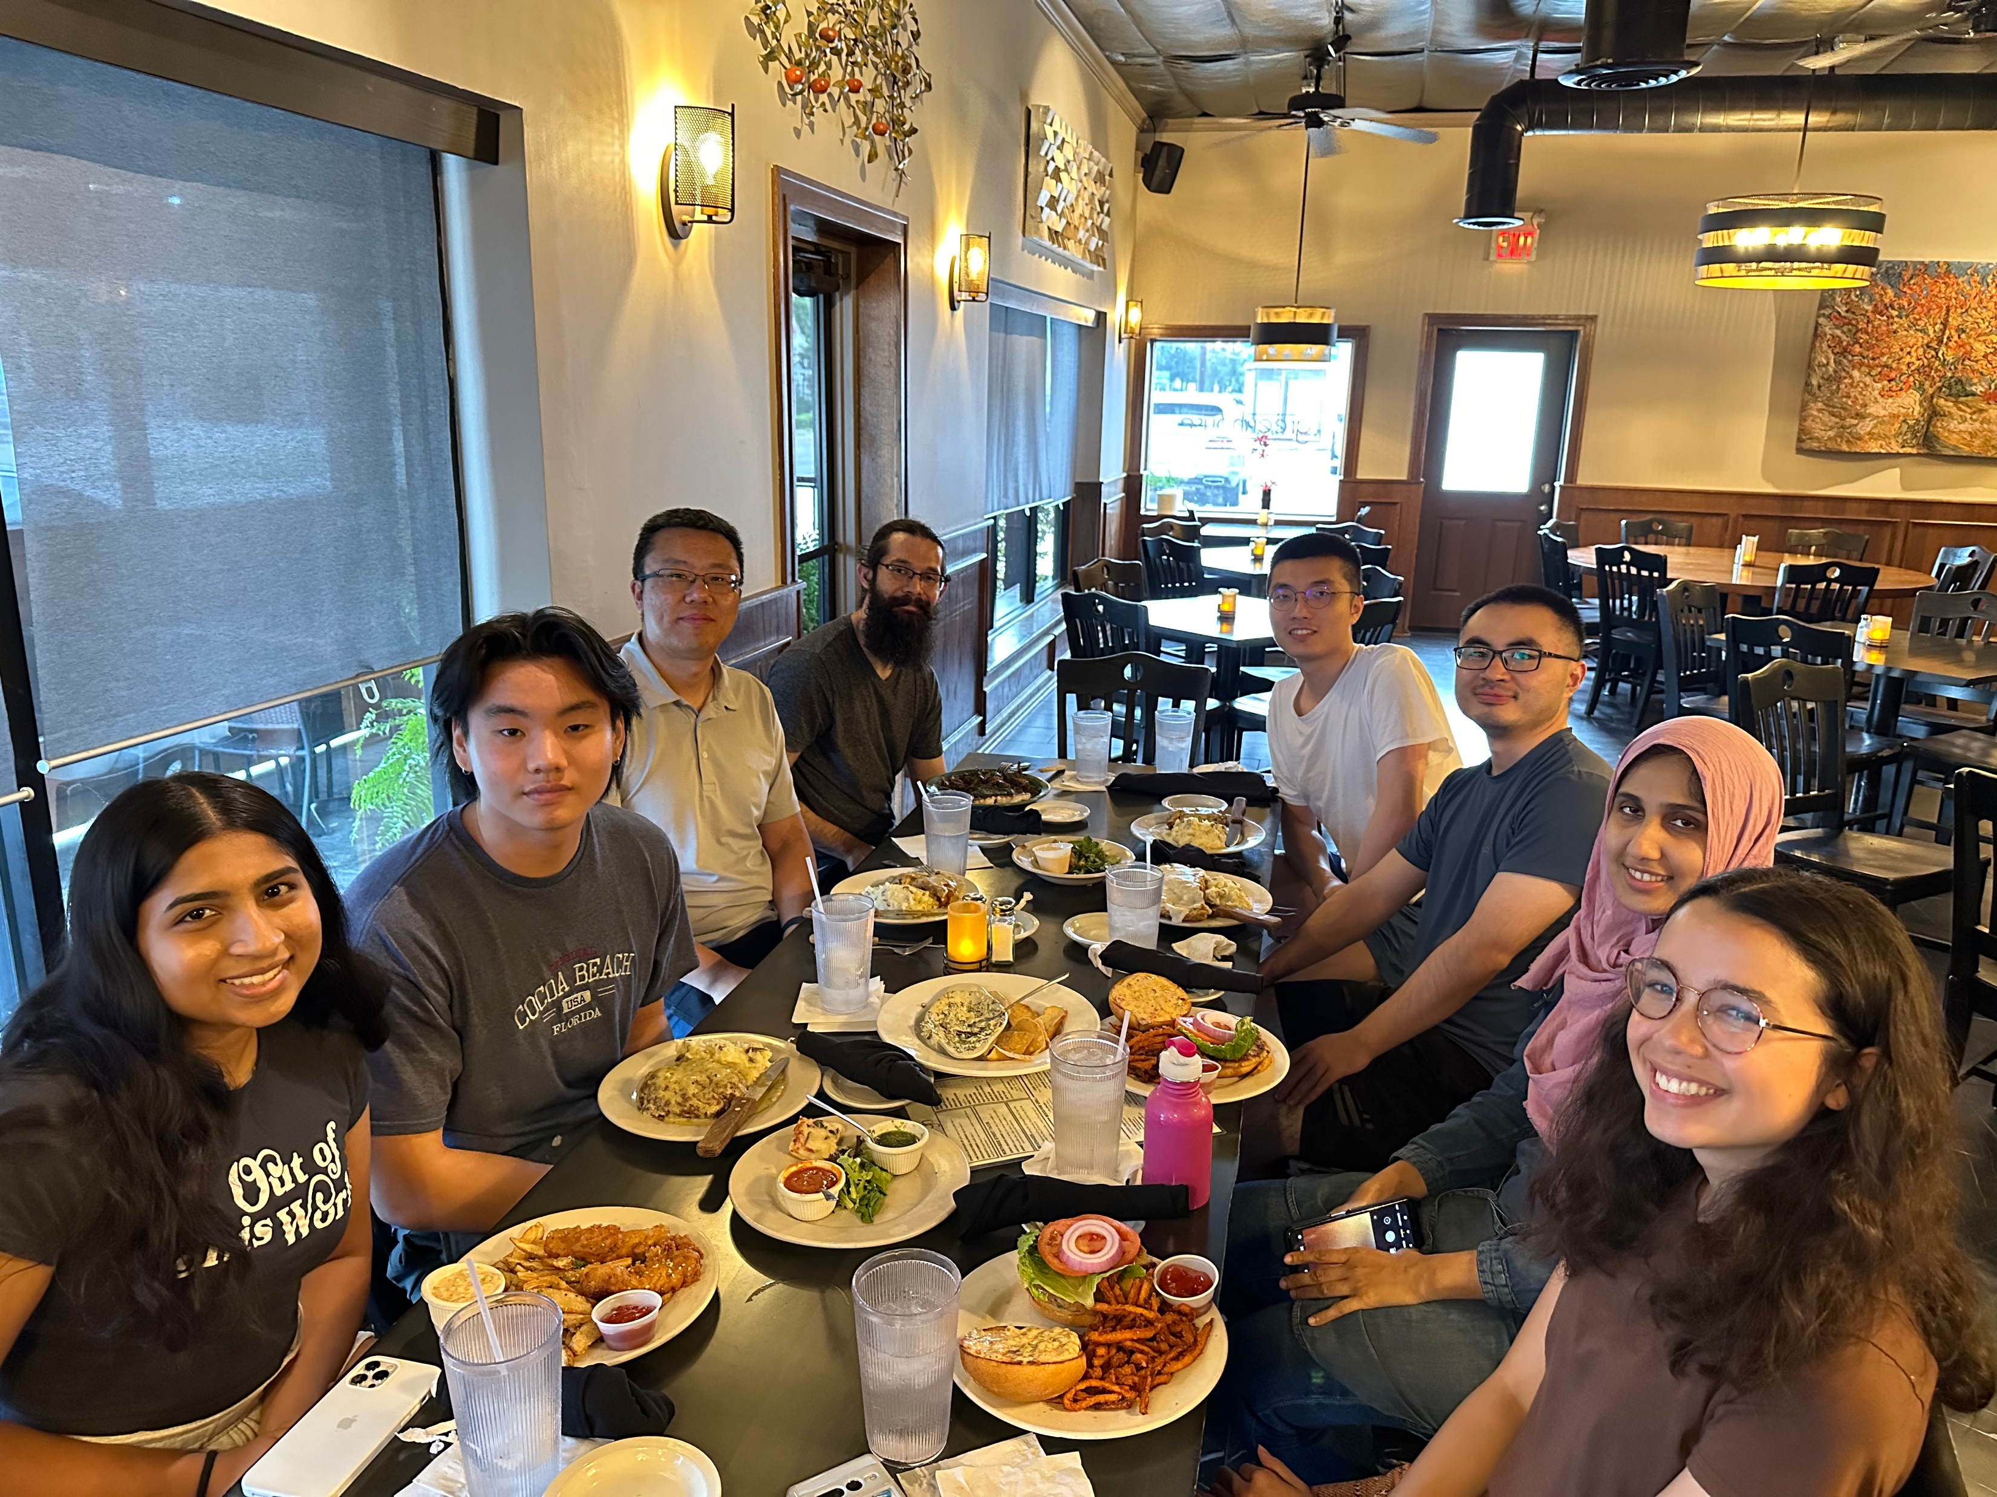
Acknowledgement to Students @ Graph Lab
Isabelle Wagenvoord (Undergraduate)
Chotepong Victor Tangton (UNT TAMS, High School)
Donavon Zhang (UNT TAMS, High School)
Sua Cho (UNT TAMS, High School)
Neha Nayak, UNT TAMS, UNT
Wang Feng (PhD student)
Haiyan Sun (PhD student)
Qianjun Wei (Visiting PhD student)
Joseph Caldwell (MS student)
Yasmeen Haleem (MS student)
Notes:
Many thanks to the talented students in our group.

Slide 18












Acknowledgement to Collaborators
Dr. H. Howie Huang
…
Dr. Hang Liu
…
Dr. Angelos Stavrou
Dr. Peng Gao
…
Dr. Binghui Wang
…
Dr. Seung-Hwan Lim
Dr. Ramakrishnan Kannan
…
Dr. Mohamed Elsabagh
Dr. Ryan Johnson
Dr. Alexandru G. Bardas
Dr. Drew Davidson …
Dr. Xing Gao
…
Dr. Pradeep Kumar
…
Dr. Leilani H. Gilpin
Dr. Zechun Cao
Dr. Shuai Li
Notes:
Many thanks to my collaborators.

Slide 19
Graph-Centric Security, Learning, and Computing
Security
Code vulnerability detection
DEFInit [Security ’21]
BugGraph [AsiaCCS ’21]
Vestige [ACNS ’21]
Cyber threat detection
API2Vec [ISSTA ’23]
NestedGNN [ICC ’22]
CyberGraph [RAID ’20]
High-Performance Computing (HPC)
Graph Algorithm/AI
HPC for graph algorithms
PeeK [SC’ 23]
Aquila [HPDC ’20]
iSpan [SC ’18]
Graph AI explanation
Illuminati [EuroS&P ’22]
HPC for graph AI
Tango [SC ’23]
TLPGNN [HPDC ’22]

Slide 20

Agenda
Background
Research Summary
Contribution #1: Applying Graph to Security Applications
Contribution #2: Explaining Graph Learning for Security Applications
Contribution #3: HPC for Graph Algorithms
Summary
Domain | Project | Graph | Graph Algorithms
Code Vulnerability Detection | BugGraph [AsiaCCS ’21] | Control Flow Graph | Graph Triplet-Loss Network
1
Notes:
Now, let’s look at how to apply graph algorithms for binary code vulnerability detection.

Slide 21
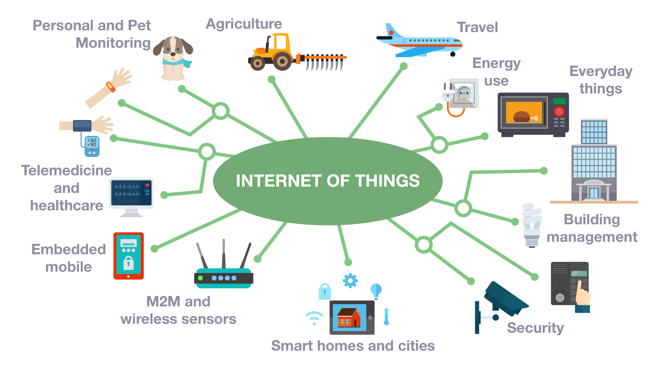
Binary Code is Prevalent
Software vendors usually do not share the source code.
A significant number of binaries are running in the wild, e.g., firmware of IoT devices.
Num. of Connected IoT Devices from 2015 to 2025
Count in billion
75 Billion
21
source: statista
Notes:
Binary code is prevalent as the software vendors usually do not share the source code.
A significant number of binaries are running in the wild, e.g., the firmware of IoT devices.
This figure shows the Num. of Connected IoT Devices from 2015 to 2025. The x-axis shows the year, and y-axis shows the count in billion.
It is estimated to reach 75 billion by 2025.

Slide 22
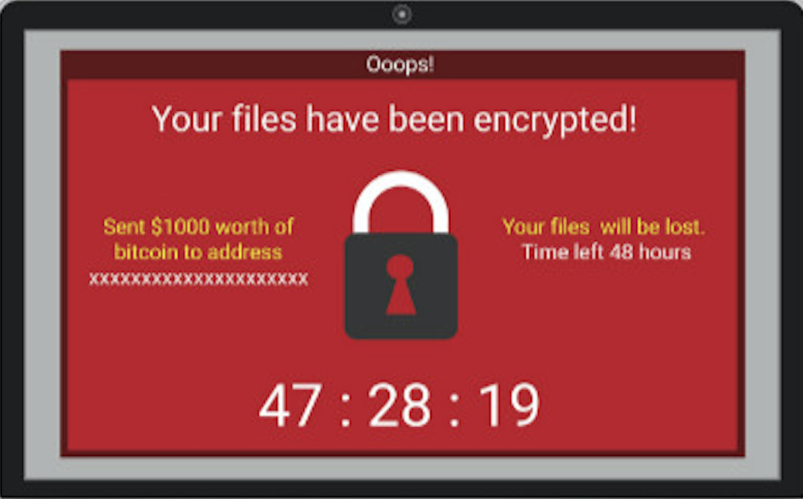
What is Vulnerability?
A vulnerability is a weakness (usually a bug) that can be exploited by the attacker to perform unauthorized activities.
Real-world impact
WannaCry ransomware infects 200,000 computers across 150 countries.
Exploits CVE-2017-0144 vulnerability in Windows’ Sever Message Block protocol.
Integer overflow
Notes:
So, what is a vulnerability?
A vulnerability is a weakness (usually a bug) that can be exploited by the attacker to perform unauthorized activities.
This is an example code of square sum. It looks good. But if you look closely,
at line 7, the value of result could exceed the limit of 32-bit integer.
This would cause an integer overflow vulnerability, which can further be exploited to cause other serious security issues.
You might still remember the WannaCry ransomware. It infects 200,000 computers across 150 countries.
It actually exploits a vulnerability in Windows’ Sever Message Block protocol.

Slide 23
Research Problem
Motivation
Open-source libraries are widely used in binaries, e.g., OpenSSL.
Up to 80% of the binaries in IoT firmware still use third-party libraries with already discovered vulnerabilities.
Research Problem
How to scalably check whether the already discovered vulnerabilities (source code) still exist in the unknow binary code.
[NDSS ’13] Cui, Ang, Michael Costello, and Salvatore Stolfo. "When firmware modifications attack: A case study of embedded exploitation." (2013). In NDSS.
Notes:
Although the binary code is closed source, the open-source libraries are widely used in binaries, e.g., OpenSSL.
And up to 80% of the binaries in IoT firmware still use third-party libraries with already discovered vulnerabilities.
So, the research problem we are focusing on is how to scalably check whether the already discovered vulnerabilities still exist in the unknown binary code.

Slide 24
Similarity-Based Solution
Source-Binary Code Similarity for Vulnerability Detection
If an unknown code is similar to a discovered vulnerability template, then the unknown code is potentially to have the same vulnerability.
Challenge:
The source and binary code are not in a canonicalized form.
Existing Solution:
Transform the problem to binary code similarity detection by compiling the source code to a binary.
101010011100000001010010100011001010101010010101010101001010100101010100
101010011100000001010010100011001010101010010101010101001010100101010100
Similar?
Unknown binary code
Vulnerability template
Notes:
An efficient type of solutions is similarity-based.
It is motivated by the observation, that If an unknown code is similar to a discovered vulnerability code, then the unknown code is potential to have the same vulnerability.
With that, the problem of vulnerability detection has become the problem of source-binary code similarity detection.
It is challenging to directly compare the source and binary code because they are not in a canonicalized form.
To solve that, the previous works would compile the source code to a binary, usually with a randomly picked compilation option.
And then, the problem becomes binary code similarity detection.
However, this kind of solutions face two major challenges.

Slide 25
Challenge #1: Low Accuracy
Low accuracy due to many combinations of compiling options
Compiler: GCC (204 versions), LLVM (55 versions), etc.
Optimization level: O-{0, 1, 2, 3, s, fast, g}
Architecture: x86, ARM, MIPS, etc.
Source code
Front end
Middle end
Back end
Binary code
Lexical analysis
IR analysis
Machine
dependent
optimization
Intermediate Representation
(IR)
111010001100
int f(){
...
Optimized IR
BIN
SRC
Syntax analysis
Machine
independent
optimization
Semantic analysis
Code generation
Compiler (family, version)
Optimization level
Architecture
Notes:
The first challenge is low accuracy due to many combinations of compiling options.
Let’s look at how the binary code is generated. Given the source code, a compiler would apply front end analysis and generate the compiler specific intermediate representation. Next, it will apply middle end analysis and optimize the intermediate representation. Later, it will use back-end analysis and generate machine-specific binary code.
So, in this process, the compiler, optimization level, and architecture would all affect how the binary code is generated.
There are so many combinations of compiling options, for example, the GCC compiler has over 200 versions and the LLVM compiler has 55 versions.
And each compiler version has at least four optimization levels.
Also, there are various architectures, including x86, ARM, MIPs, and others. So, two randomly picked binary codes could have very different compiling options. And this would dramatically lower the accuracy.

Slide 26
Challenge #1: Low Accuracy
Low accuracy due to many combinations of compiling options
Compiler: GCC (204 versions), LLVM (55 versions), etc.
Optimization level: O-{0, 1, 2, 3, s, fast, g}
Architecture: x86, ARM, MIPS, etc.
lea ecx, [rdi-1]
mov edx, ecx
shr edx, 2
lea esi, ds:0[rdx*4]
test esi, esi
jz loc_4007F8
x86-LLVM-3.3-O1
Example source code
x64-GCC-4.8.5-O3
Notes:
Let me explain why with the square sum function example.
using compiler LLVM-3.3 with optimization level O1 on x86 architecture, we will get a disassembled binary code with its control flow like this.
But if we use GCC-4.8.5 with optimization level O3 on x64 architecture, we will get a disassembled binary code like this. The assembly codes are ignored because the code size is too big.
In this case, both the code size and control flows are greatly changed,
mainly because the optimization level O3 applies loop related optimization techniques, such as, loop unrolling and tree vectorization.
It is quite challenging to find these two disassembly codes similar no matter from instructions or code structures.

Slide 27
Challenge #2: Low Coverage of Similar Code Types
Three types of similar code
Type-1: Difference in the white space, blank line, layout, and comment.
Type-2: Difference in identifiers, literals, and data types.
Type-3: Difference in statements, including changed, added, or deleted.
Low coverage as prior works only focus on Type-1/2 similar code
Type-3 contributed to over 50% of all vulnerabilities discovered by code similarity [Islam et al. ESEM’17]
Example source code
Type-1
Type-2
Type-3
Notes:
The second challenge is from the source code level. There are three types of similar code.
By definition, type-1 has Difference in the white space, blank line, layout, and comment.
type-2 has difference in identifiers, literals, and data types.
type-3 has difference in statements, including changed, added, or deleted.
Existing works only focus on type-1/2 similar code, but the type-3 similar code actually contributed to over 50% of all vulnerabilities discovered by code similarity methods.
The type-3 similar code is challenging because it could change the code structure and instructions.
For example, this if statement would create a different control flow and introduce new instructions.

Slide 28
Overview of BugGraph
BugGraph: a two-step source-binary code similarity detection system
Step 1: Source binary canonicalization
First work to identify compilation provenance for source-binary code similarity detection.
Step 2: Code similarity computation
Ranking-based graph triplet-loss network to better detect type-3 similar code.
Notes:
To address these challenges, I design BugGraph, a two-step source-binary code similarity detection system.
The first step addresses the challenge of comparing binaries with different compilation options. It is the first work to identify compilation provenance for source-binary code similarity detection.
Then, we compile the source code to a binary with the same compilation options. To this end, the inputs of source-binary codes become two binary codes with the same compilation options.
In the second step, we convert the binary code to attributed control flow graph,
and design a ranking-based graph triplet-loss network to compute code similarity. This method can significantly improve the accuracy, especially for the challenging type-3 similar code.
Next, I will explain the details of the two steps.

Slide 29

Step 1: Source Binary Canonicalization
Key Insight:
Provenance-guided source binary canonicalization
Compilation Provenance
<architecture, compiler family, compiler version, optimization level>
Idiom feature extraction
I1: mov rax, MEM
I2: mov MEM, rax
{I1: 0.5, G1: 0.3, …}
…
Disassembly
tool
Build attributed function call graph
{I1: 0.1, I2: 0.2, …}
{I2: 0.8, G2: 0.9, …}
Attention-based Graph Neural Network
1010100111
BIN
Graphlet feature extraction
…
G1
G2
Provenance
FCG construction
{I2: 0.6, G1: 0.7, …}
{I1: 0.2, I2: 0.4, …}
Notes:
The key insight of our first step is to use the compilation provenance to guide the canonicalization of source-binary code.
Here, the compilation provenance is regarded as the four major affecters during the compilation process.
They are architecture, compiler family, compiler version, and optimization level.
Given a binary, we first disassemble it to assembly code.
Later, we extract three types of features, the idiom features, the graphlet features on the control flow graph, and the function call graph.
With these features, we build a new representation, named attributed function call graph (AFCG).
Next, we build a provenance prediction model with an attention-based graph neural network.

Slide 30
Compilation Provenance Identification
Source code fragment of CVE-2015-1792
Provenance 1: x86-GCC-4.8.4-O2
Provenance 2: x86-LLVM-5.0-O0
Idiom features
Graphlet features
Function call graph
Notes:
Now, let’s look at the features.
I will use this source code fragment from a real vulnerability as an example.
Here is the assembly code with compilation provenance x86-gcc-4.8.4-O2,
And this is the assembly code with a different provenance.
First, we extract the idiom features from the instruction level because different compilers usually have different rules for instruction, register, and instruction ordering.
For example, for this line of source code, the first provenance uses one mov instruction and base address register ebx. But the second provenance uses two mov instructions, and base register eax. So, to capture these differences, we first normalize the operands, such as memory address, constants, and function name. Then, we extract the unique instruction patterns and their combinations as the instruction features.
The second type of feature is graphlet feature. Different compilation provenances have different rules on how the basic blocks form the control flow graph. In this example, the first compilation provenance generates 2 nodes, but the second provenance only generates 1 node. To capture these differences, we extract graphlet features. First, we normalize the control flow graph by assigning a type value to each node and edge based on the instructions. Then we mine the graph patterns as the feature.
The third type of feature is function call graph. Many compiler optimizations work on the binary level, such as, function inlining, procedure reordering, and interprocedural dead code elimination. So, we use the function call graph to capture these differences. Combining them together, we build an attributed function call graph.

Slide 31
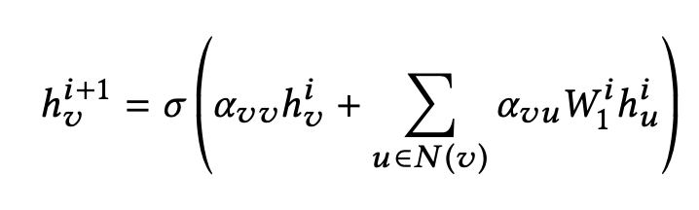
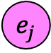
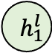
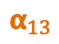
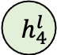
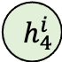
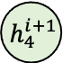
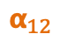
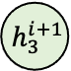
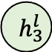
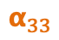
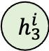
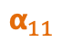
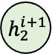
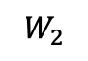
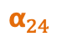
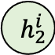
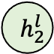

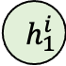
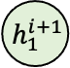
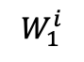
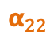
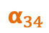
Attributed Graph Embedding
Graph Embedding
Graph attention network (GAT) [Veličković et al. ICLR ’18]
Objective function:
$$W_{1}^{i}$$
$$W_{2}$$
$$h_{1}^{i}$$
$$α_{11}$$
$$h_{1}^{i+1}$$
$$h_{1}^{l}$$
$$h_{1}$$
$$α_{12}$$
$$h_{2}^{i}$$
$$α_{22}$$
$$α_{13}$$
$$h_{2}^{i+1}$$
$$h_{2}^{l}$$
$$h_{2}$$
$$h_{3}$$
$$α_{24}$$
…
$$e_{j}$$
$$h_{3}^{i}$$
$$α_{33}$$
$$h_{3}^{i+1}$$
$$h_{3}^{l}$$
$$α_{34}$$
$$h_{4}$$
$$h_{4}^{i}$$
$$h_{4}^{i+1}$$
$$h_{4}^{l}$$
$$α_{44}$$
Input
i-th
(i+1)-th
l-th
Output
Label
Notes:
With the attributed graph, we build a provenance identification model with the graph embedding method.
We use an attention-based graph neural network, named graph attention network.
Given an input graph with node attribute,
The graph attention network would iteratively update a node’s embedding by aggregating the embeddings of its neighbor and itself from the previous layer.
In the end, graph attention network would accumulate the node embeddings to generate a graph embedding. Based on the label, we compute the loss value and back propagate to optimize the network.
To this end, we build a provenance identification model. Once we identify the compilation provenance, we would compile the source code with the same provenance.

Slide 32
Step 2: Code Similarity Computation
Key Insight:
Represent binary code with attributed control flow graph.
Use ranking-based graph triplet-loss network to identify different types of similar code.
Notes:
Then the problem becomes binary code similarity detection.
The first step handles the difference from compilers. In this step, we mainly need to worry about how to identify the binaries with similar source code.
So, we first represent the binary code with attributed control flow graph.
Later, we use ranking-based graph triplet-loss network to identify different types of similar code.

Slide 33
Binary Code to Attributed Graph
Attributed control flow graph
Control flow graph: essential code structure feature
Attributes: syntax features
The problem has become attributed graph similarity problem.
Label ?
int __cdecl do_free_upto(void *, int)
...
jz short loc_81A85E6
Instruction | # of numeric constants
 | # of string constants
 | # of transfer instructions
 | # of calls
 | # of arithmetic instructions
 | # of instructions
Structure | # of children
 | Betweenness centrality
{2, 0, 1, 0, 3, 1, 2, 0}
...
jnz short loc_81A85B6
...
call BIO_free_all
{0, 0, 3, 2, 12, 0, 2, 0.083}
{0, 0, 1, 1, 3, 0, 0, 1, 0.083}
jmp short loc_81A85F2
{0, 0, 1, 0, 1, 0, 1, 0.083}
...
do_free_upto endp
{1, 0, 0, 0, 2, 1, 0, 0}
Assembly code of CVE-2015-1792 compiled with x86-GCC-4.8.4-O0
[CCS’16] Qian Feng, Rundong Zhou, Chengcheng Xu, Yao Cheng, Brian Testa, and Heng Yin. 2016. Scalable Graph-based Bug Search for Firmware Images. In CCS 2016.
Notes:
The control flow graph reserves the code structure, it is an essential representation for code analysis.
For example, this figure shows the Assembly code of a vulnerable binary code. But, only using the control flow graph is not enough because two different codes might share quite similar control flows.
So, we attribute each vertex with syntax features. In total, we extract 8 features, including 6 instruction and 2 structure features as shown here.
With that, the binary code is converted to an attributed graph.
Now, the code similarity problem has become the attributed graph similarity problem.
We also use graph embedding method, but there is one problem. We don’t have a label for each code.

Slide 34
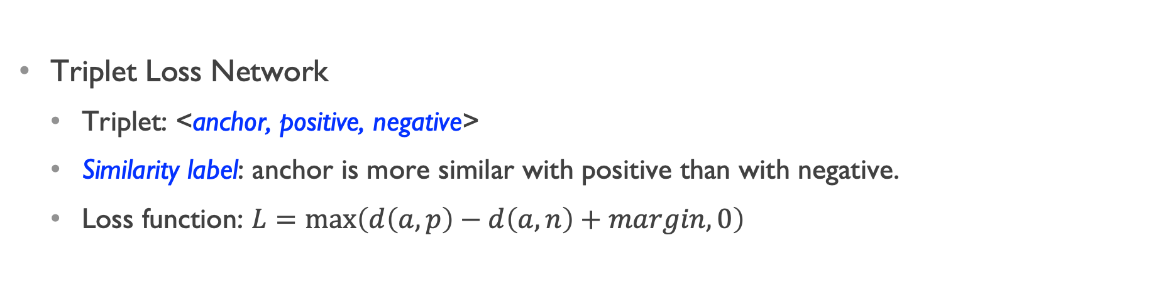
Ranking-Based Triplet Loss Network
Triplet Loss Network
Triplet: <anchor, positive, negative>
Similarity label: anchor is more similar with positive than with negative.
Loss function: $L=\max\left(d\left(a, p\right)−d\left(a, n\right)+margin, 0\right)$
Positive
Positive
Anchor
Anchor
Learning
Negative
Negative
Notes:
So, to address this label problem, we use a Ranking-Based Triplet Loss Network.
a triplet includes anchor, positive, and negative elements.
The label is on the triplet, not on each element. Basically, the label means the anchor is more similar with the positive than with the negative.
Based on this loss function, the triplet network can generate loss values to supervise the learning process of the graph attention network.
During the learning process, the triplet loss network will learn to put the anchor and positive elements more similar than the anchor and negative elements.

Slide 35
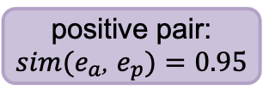
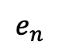
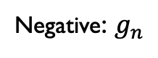
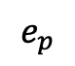
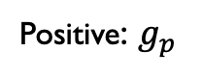
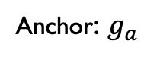
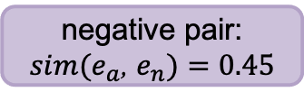
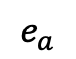
Graph Triplet-Loss Network for Code Similarity
Ranking similar code:
Type-1 > Type-2 > Type-3 > Different
Anchor: $g_{a}$
Positive: $g_{p}$
Negative: $g_{n}$
<1,3,7,0,3,1,0,0>
d
Graph Attention Network
Graph embedding
$$e_{a}$$
$$e_{p}$$
$$e_{n}$$
Triplet Loss
Type-1
positive pair:
$sim(e_{a}$, $e_{p})=0.95$
negative pair:
$sim(e_{a}$, $e_{n})=0.45$
Type-2
Type-3
$L_{i}=max⁡\{sim(e_{a}$, $e_{n})$ - $sim(e_{a}$, $e_{p})+$𝚫, $0\}$
Different
Notes:
Combining them together, we get our graph triplet-loss network.
Taking a triplet of anchor, positive, and negative graphs as input,
the graph attention network generates the graph embedding for each graph.
Then, we use the triplet loss network to compute the loss value.
Next, we back propagate the loss value to the graph attention network and supervise its learning process.
In the end, our graph triplet-loss network would be able to rank different similar code in the high dimensional space like this.

Slide 36
Experiment
 | Software | Compilation Provenance | Similarity Types | # Binaries | # Functions
Train | SNNS-4.2, PostgreSQL-7.2 | Architecture: x86 Compiler: GCC-{4.6.4, 4.8.4, 5.4.1}, LLVM-{3.3, 3.5, 5.0} Optimization: O0 – O3 | Type-1/2/3 | 600 | 493,841
Test | Binutils-{2.25, 2.30}, Coreutils-{8.21, 8.29} |  | Type-1/2/3 | 5,568 | 2,648,627
Total | - | 24 | Type-1/2/3 | 6,168 | 3,142,468
Dataset
6K+ binaries, 3M+ functions
24 compilation provenances
Training and testing use different software
Search 3,000 Type-1/2/3 similar code (1,000 for each)
Report the top-k hit rate, the smaller k the more important
Notes:
Now let’s look at the Experiment.
Here is the dataset we used.
We compiled six software with 24 compilation provenances. That generates over six thousand binaries, and 3 million functions.
The training and testing use different software to avoid the potential bias caused by code sharing in the same software.
We search 3,000 type-1/2/3 similar code.
We report the top-k hit rate, which is the smaller k the more important. Because the security analysists would start investigating from the top. So, the higher we rank the target, the better.

Slide 37
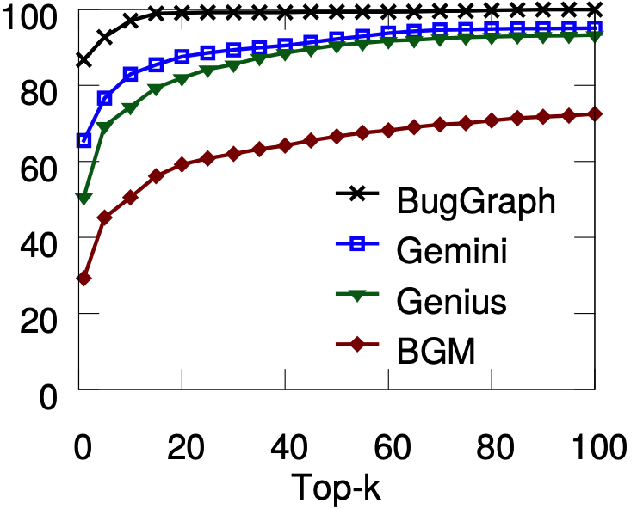
Source-Binary Code Similarity Test
Compilation provenance accuracy:
82% overall accuracy
100%, 100% for architecture, compiler family
96%, 84% for version, and optimization
Type-1 similar code:
E.g., Top-5 hit rate
BugGraph, 93%
Gemini [Xu et al. CCS ’17], 77%
Genius [Qian et al. CCS ’16], 69%
BGM [Bipartite Graph Matching], 45%
Top-k Hit Rate of Type-1 Similar
Hit rate (%)
Notes:
As for compilation provenance, our method can get 82% overall accuracy.
We get 100% accuracy for architecture and compiler family.
For compiler version and optimization level, we get 96% and 84%.
We compared BugGraph with three works.
Gemini and Genius are two recent works, BGM is a baseline method using bipartite graph matching.
For type-1 similar code, BugGraph gets better result than compared works, especially for smaller k values.

Slide 38
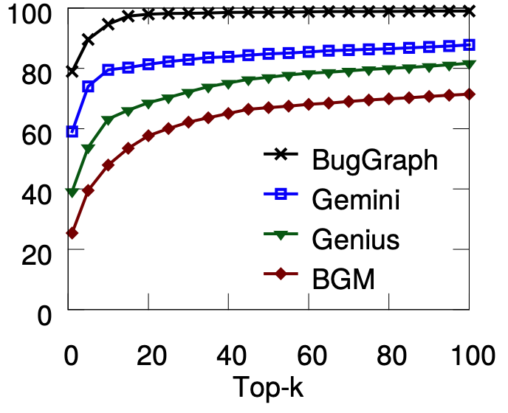
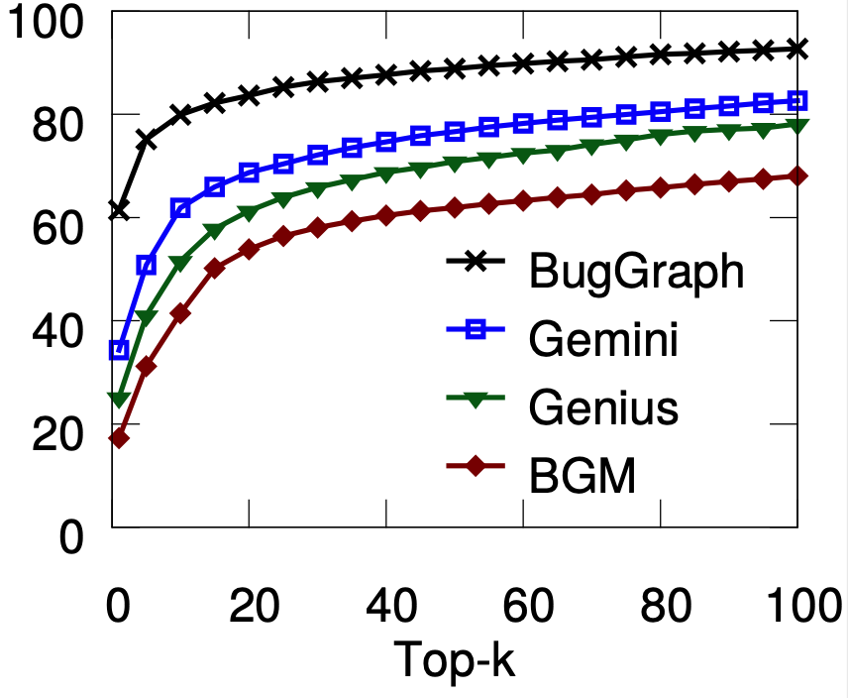
Source-Binary Code Similarity Test
Type-2 Similar Code (top-5 hit rate)
BugGraph, 90%
Gemini, 74%
Genius, 54%
BGM, 40%
Type-3 Similar Code (top-5 hit rate)
BugGraph, 75%
Gemini, 51%
Genius, 41%
BGM, 31%
Top-k Hit Rate of Type-2 Similar
Top-k Hit Rate of Type-3 Similar
Hit rate (%)
Hit rate (%)
Notes:
For type-2 similar code, BugGraph achieves 90% for top-5 hit rate. That is over 16% higher than the rest.
For type-3 similar code, BugGraph achieves 75% for top-5 hit rate. That is over 24% higher than the rest.

Slide 39
Detecting Vulnerabilities from Firmware
Tested firmware: ArcherC9, AD7200, TouchP5, ArcherC2600, ArcherC5200, and ArcherC5400
Vulnerability database: 218 known vulnerable code
Findings:
Identified 140 vulnerable code from 42 unique CVEs.
Old vulnerabilities still exist.
CVE | # Appear | Vulnerability type | CVE | # Appear | Vulnerability type | CVE | # Appear | Vulnerability type
2016-6303 | 5 | out-of-bounds write | 2016-0702 | 5 | side-channel attack | 2015-0206 | 4 | Allow DoS attack
2016-6302 | 5 | Allow DoS attack | 2016-0701 | 2 | Miss required crypto | 2015-0205 | 4 | Allows remote access
2016-2842 | 5 | Out-of-bounds write | 2015-3197 | 3 | Man-in-the-middle | 2015-0204 | 4 | Downgrade attacks
2016-2182 | 5 | Out-of-bounds write | 2015-1794 | 2 | segmentation fault | 2014-8176 | 4 | DoS overflow
2016-2180 | 5 | Out-of-bounds read | 2015-1792 | 4 | Allows DoS attack | 2014-5139 | 3 | NULL pointer dereference
2016-2178 | 5 | Side-channel attack | 2015-1791 | 4 | Double free | 2014-3572 | 4 | Downgrade attacks
2016-2176 | 2 | buffer over-read | 2015-1790 | 4 | NULL pointer dereference | 2014-3567 | 4 | Allow DoS attack
2016-2109 | 2 | memory consumption | 2015-1789 | 4 | Out-of-bounds read | 2014-3511 | 1 | Man-in-the-middle
2016-2105 | 2 | heap memory corruption | 2015-1788 | 4 | Allow DoS attack | 2014-3508 | 1 | information leakage
2016-0799 | 5 | Out-of-bounds read | 2015-0292 | 4 | Integer underflow | 2014-3470 | 1 | NULL pointer dereference
2016-0797 | 3 | Integer overflow | 2015-0288 | 4 | NULL pointer dereference | 2014-0221 | 1 | Allow DoS attack
2016-0705 | 5 | Double free | 2015-0287 | 4 | invalid write operation | 2014-0198 | 1 | NULL pointer dereference
2016-0704 | 4 | Information leakage | 2015-0286 | 4 | invalid read operation | 2014-0195 | 1 | Buffer overflow
2016-0703 | 1 | Man-in-the-middle | 2015-0209 | 4 | Use-after-free | 2013-6449 | 1 | Daemon crash
Notes:
Next, we apply BugGraph to detect the vulnerabilities from real firmware.
We tested six firmware from routers.
We build a vulnerability database with 218 known vulnerable code.
Here are our findings.
We identified 140 vulnerable code from 42 unique vulnerabilities.
This table summarizes the vulnerability, the number of appearances, and vulnerability type
We also find some old vulnerabilities still exist, for example, this one is 8-years-old, and it’s still there.

Slide 40

DEFInit: Detecting Exposed Android Init Routines
Android Init routines (services and actions)
Running in high privileges
Can be customized by the vendor
DEFInit: Use graphs to model the indirect attack and behavior
Control flow graph and dependency graph
Deployed in Quokka (a mobile security company)
Findings:
Tested 259 firmware from top-21 Android vendors.
Found 644 exposed Init routines with sensitive behaviors (all customized).
Manually verified 191 new vulnerabilities.
Boot ROM
Init Process
Init Process
Bootloader
Zygote
Kernel
System Server
Android booting process
Vulnerability type | # of Vulnerabilities
Disable SELinux | 9
Disable WiFi | 26
Record screen | 5
Sniff WiFi traffic | 15
Others | 136
Total | 191
Security 2021
Notes:
We also studied the vulnerabilities in Android.
In particular, we studied the Init services and actions in Android firmware. The Init process is a key step in the Android booting process. It is the first user-space process. It also manages the Init services and actions, which are running with high privileges, like root. They can be customized by the vendors.
As vendors’ customization might introduce new security risks, we built an end-to-end system, named DEFInit, to automatically identify them.
A key methodology in our design is using graphs to model the indirect attack and behaviors. We built control flow graphs and dependency graphs. The system has been deployed in Kryptowire, a security company specialized in code analysis and mobile security.
We tested 259 Android firmware and found 644 exposed Init routines with sensitive behaviors. They are all customized.
Among them, we have manually verified 191 new vulnerabilities. This table summarized some of the serious vulnerabilities, including disabling SELinux, Disabling WIFi, recording screen, and Sniffing WiFi traffic.

Slide 41
Summary of Applying Graph to Security Applications
New Insight and Method:
BugGraph, first work to identify compilation provenance for code similarity detection.
Improved both accuracy and coverage for less similar code.
Reported to DARPA CHASE
DEFInit, first study on security risks caused by customized Android Init services and actions.
Impact:
BugGraph identified 140 vulnerable code from 6 IoT firmware.
DEFInit discovered 191 new vulnerabilities from 259 Android firmware.
NSF OAC CICI: UCSS: Secure Containers in High-Performance Computing Infrastructure (PI, $600k)
Notes:
In summary,
BugGraph is the first work to identify compilation provenance for code similarity detection. It has significantly improved both accuracy and coverage for less similar code. This project has been reported to the DARPA CHASE program.
DEFInit is the first study on security risks caused by customized Android Init services and actions.
It has been deployed in Kryptowire.
BugGraph Identified 140 vulnerable code from 6 IoT firmware.
DEFInit has discovered 191 new vulnerabilities from 259 Android firmware.

Slide 42
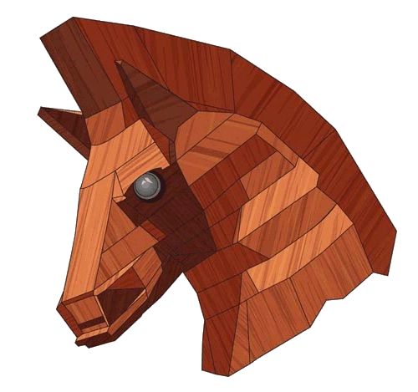
Agenda
Background
Research Summary
Contribution #1: Applying Graph to Security Applications
Contribution #2: Explaining Graph Learning for Security Applications
Contribution #3: HPC for Graph Algorithms
Summary
Illuminati: Towards Explaining Graph Neural Networks for Cybersecurity Analysis
EuroS&P 2022
Notes:
All right, now let's look at how to explain GNNs for security analysis.

Slide 43
GNN for Source Code Vulnerability Detection
Vulne-rable
Benign
Input source code
Attributed control and data flow graph (AFG)
Pre-trained GNN model
Notes:
First, let’s look at how do we apply GNN for source code vulnerability detection.
Given a source code like this,
We first convert it to an attributed control and data flow graph (or AFG). Each node denotes a line of code, and each edge either denotes the control flow or the data flow between the nodes. The node attributes represent the keywords from each line of the code.
Now we have the AFG, we also know whether this code is vulnerable or not. In that case, this task is actually a graph classification task.
With that, we can train a GNN model for graph classification.
% So, why would we convert the code to a graph like this?
% Control flow: 9 → 11 → 12
% Data flow: 5 → 9 and 5 → 12
% Attributes: free (line 9) and free (line 12)

Slide 44
Perturbation-Based GNN Explanation
Objective function
Inference
X
Vulne-rable
Pre-trained GNN model
New subgraph generation
Notes:
Now let’s look at what do we mean by GNN explanation.
Take a graph and a pre-trained GNN model as inputs, our goal is to explain which nodes, edges, and features contribute to the prediction.
First, we employ the mask generation algorithms to obtain different types of masks for nodes, edges, or features. These masks denote the importance of the corresponding nodes, edges, or features. The higher the more important.
Then the masks will be applied to the input graph to generate a new subgraph.
Next, this new subgraph will be input to the pre-trained GNN model for inference.
With the output, the objective function will calculate the loss value based on whether the new prediction result is same with the original result. Finally, the masks will be updated based on the loss value.

Slide 45
Perturbation-Based GNN Explanation
Notes:
In the end, these masks are our explanation results, denoting whether a node, edge or feature is important.

Slide 46
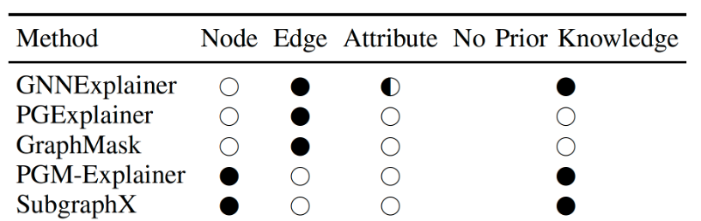
Challenge #1: Not Comprehensive
Can we use existing GNN explanation methods?
Comprehensive: covering nodes, edges, attributes, and not requiring prior knowledge
Notes:
Existing GNN explanation methods face two major challenges when they are applied to security applications.
The first one is, not comprehensive. Here, the comprehensive means covering nodes, edges, attributes, and not requiring prior knowledge.
These are all important for security applications.
However, existing methods are not comprehensive.

Slide 47
Challenge #2: Not Practical for Security Analysis
GNNExplainer
PGM-Explainer
Input source code
Attributed control and data flow graph
Pre-trained GNN model
Explanation results
Notes:
The second challenge is, the generated explanation result is not practical for security analysis.
For this example code, when we apply GNNExplainer, it will generate an output like this.
Similarly, when we apply PGM-Explainer, it will generate this.
These explanations do not tell why this code is a vulnerability. It could even mislead the security analysts.

Slide 48
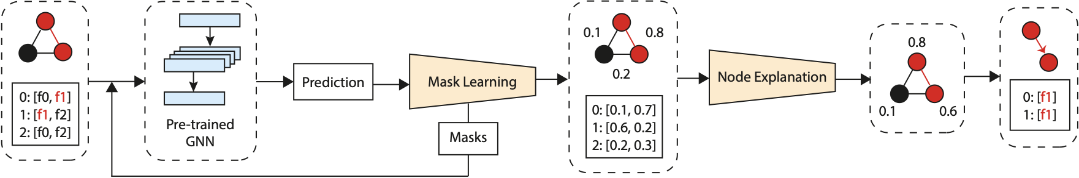
Overview of Illuminati
Illuminati
Key idea: Jointly explain the importance of nodes, edges, and node-specific features.
First GNN explanation method designed for cybersecurity applications.
Workflow
Step1: learn the importance scores for edges and node-specifc features.
Step2: estimate the importance scores for nodes.
Step3: extract the corresponding subgraph.
Notes:
To address this challenge, we design Illuminati.
The key idea of Illuminati is to jointly explain the importance of nodes, edges, and features.
It is the first GNN explanation method designed for cybersecurity applications.
Basically, Illuminati has three steps.
First, it learns the importance scores for edges and features.
Then, it estimate the importance scores for nodes.
In the end, it extract the corresponding subgraph.

Slide 49
Illuminati: Joint Explanation
Illuminati firstly learns the importance scores for edges and node-specific features.
Notes:
First, Illuminati learns the importance scores for edges and features.
We randomly initialize the importance scores of edges and node attributes, then convert them into masks and apply the masks to the input graph. We feed the masked graph into the GNN model. With the feedback from the GNN model, we can update the importance scores.

Slide 50
Illuminati: Joint Explanation
Next, Illuminati estimates the importance scores for nodes.
Notes:
Next, Illuminati estimates the importance scores for nodes.
In each GNN layer, the message is passed from one node to its neighbor. We aggregate the corresponding importance scores for edges and attribute into message importance scores. They are categorized into incoming messages and outgoing messages. Later, we aggregate the importance scores for incoming and outgoing messages into the final node importance scores.

Slide 51
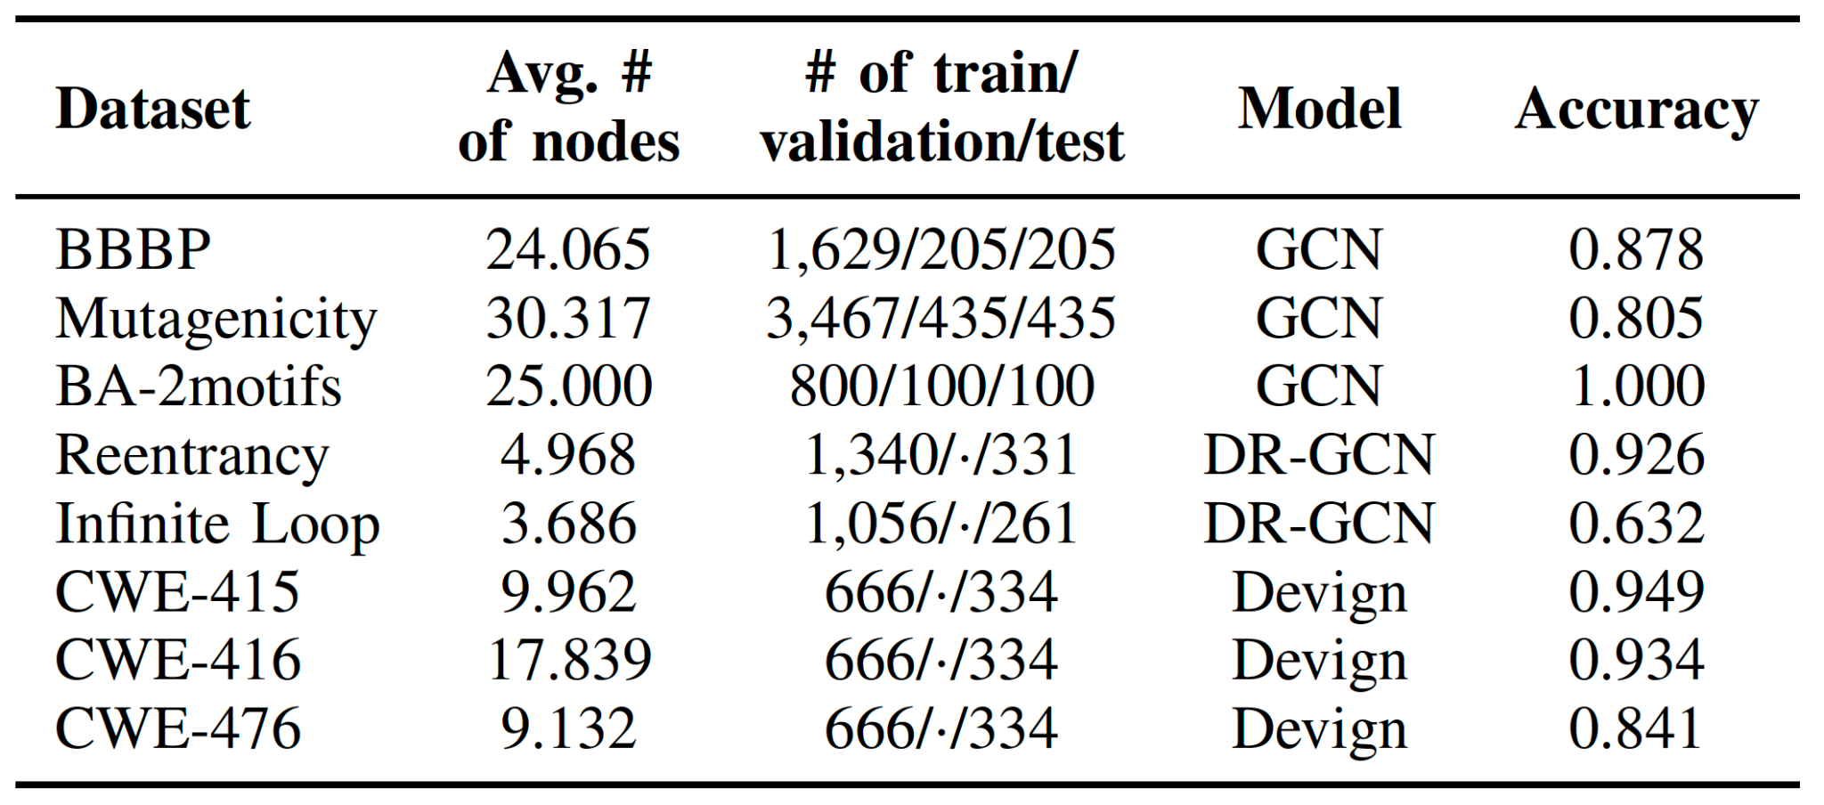
Experiment
Public datasets & GNN models
Code vulnerability detection
Dataset: A well-labeled dataset from NIST Software Assurance Reference Dataset (SARD), named Julie [2]
Model: Devign [3]
Smart contract vulnerability detection
Dataset: ESC (Ethereum Smart Contracts) and VSC (VNTchain Smart Contracts)
Model: DR-GCN [1]
[1] Yuan Zhuang, Zhenguang Liu, Peng Qian, Qi Liu, Xiang Wang, and Qinming He. 2021. Smart contract vulnerability detection using graph neural networks. In IJCAI'20.
[2] NIST, “Software assurance reference dataset,” https:// samate.nist. gov/ SARD/ , 2017.
[3] Yaqin Zhou, Shangqing Liu, Jingkai Siow, Xiaoning Du, and Yang Liu. 2019. Devign: effective vulnerability identification by learning comprehensive program semantics via graph neural networks. Proceedings of the 33rd International Conference on Neural Information Processing Systems.
Notes:
Here are the datasets and GNN models we used for this experiment.
We tested two cybersecurity applications, one is code vulnerability detection,
the other is smart contract vulnerability detection.

Slide 52
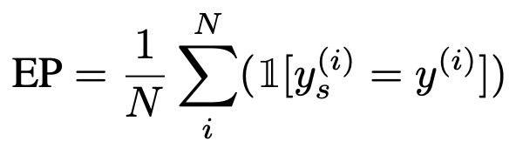
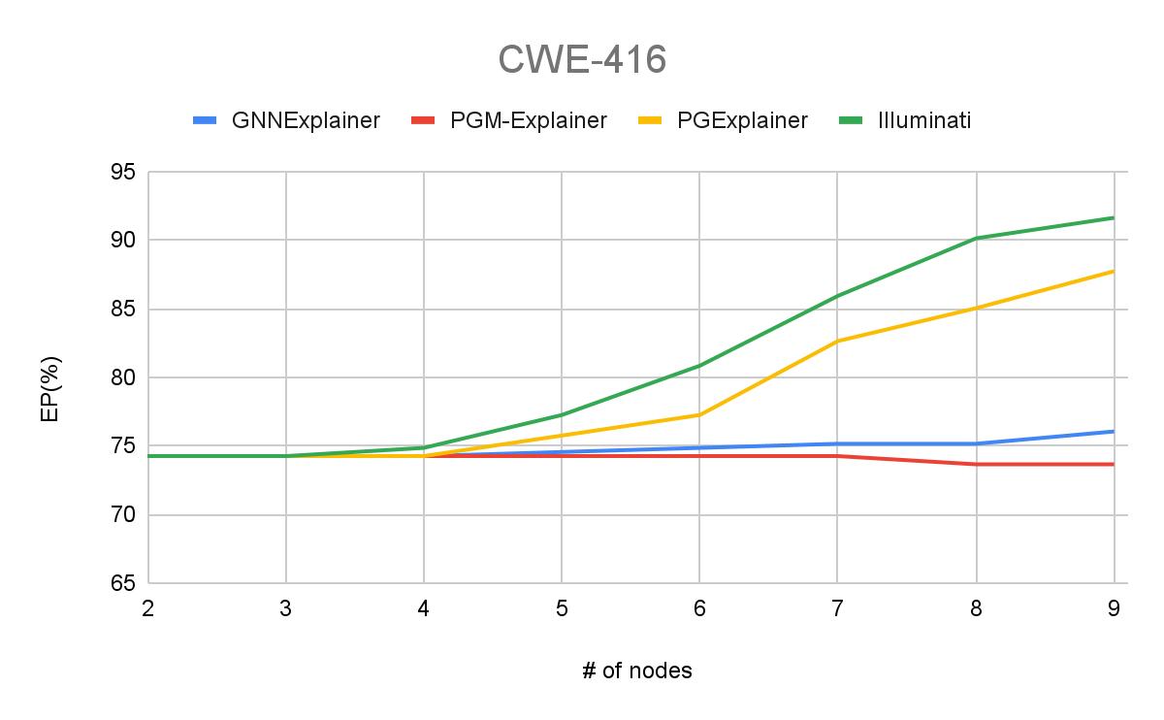
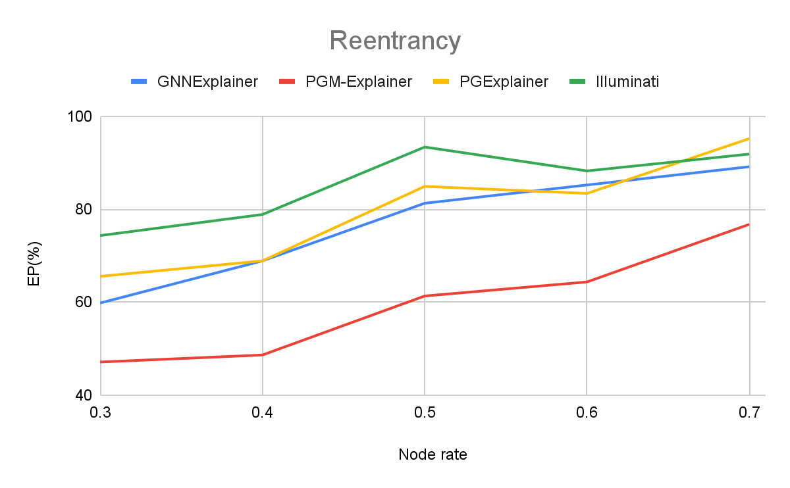
Evaluation
Essentialness Percentage (EP)
Measures the percentage of subgraphs in the dataset that retain the original predictions.
Comparison
GNNExplainer [NeurIPS ’19], PGM-Explainer [NeurIPS ’20], PGExplainer [NeurIPS ’20]
The higher
the better
Code vulnerability detection
Smart contract vulnerability detection
Notes:
We use the Essentialness Percentage metric. It measures the percentage of the identified important subgraphs that retain the original predictions.
We compare our work with three existing works, GNNExplainer, PGM-Explainer and PGExplainer.
Here is the result of code vulnerability detection. The x-axis denotes the number of nodes, while y-axis denotes the EP value. One can see, Illuminati achieves the highest EP.
Here is the result for Smart contract vulnerability detection, we can get the similar observation.

Slide 53
Case Study - Code Vulnerability Detection
GNNExplainer
PGM-Explainer
Illuminati
Input source code
Attributed control and data flow graph
Pre-trained GNN model
Explanation results
Notes:
Back to the motivating example code, with Illuminati,
Here are what we get.
Basically, we can capture the important nodes and the features. Such information can assist the security analysts to quickly make the correct decision.

Slide 54
Summary of Explaining Graph Learning for Security
New Method:
Illuminati, first work to comprehensively explain GNN for security applications.
Future Work:
Design an efficient computation system for GNN explanation methods.
Apply GNN explanation methods to specific scientific applications.
DOE VFP Program: Efficient Computation for Graph Neural Network Explanation Methods on GPUs
Notes:
In summary, Illuminati is the first work to comprehensively explain GNN for security applications.
In the future, we plan to design an efficient computation system for GNN explanation methods because we notice the computation is slow. We are working on this project with Seung-Hwan right now.
We also plan to apply these GNN explanation methods to specific applications. If you have any interesting GNN applications, maybe we can talk.

Slide 55

Agenda
Background
Research Summary
Contribution #1: Applying Graph to Security Applications
Contribution #2: Explaining Graph Learning for Security Applications
Contribution #3: HPC for Graph Algorithms
Summary
TLPGNN: A Lightweight Two-Level Parallelism Paradigm for Graph Neural Network Computation on GPU
HPDC 2022
Notes:
In the last part, I will discuss our work on HPC for GNNs.

Slide 56

Computation of Graph Neural Networks (GNNs)
Input: attributed graph
Graph
Feature matrix (new addition over conventional graph algorithms)
Middle: Multiple GNN layers
Training: forward propagation + backward propagation
Inference: forward propagation
Output: new node/graph embedding for downstream tasks
Node classification, graph classification, link prediction, etc.
B
B
C
A
…
C
A
Layer
1
Layer
n
D
D
Input
GNN layers
Output
Notes:
The input of GNNs is usually an attributed graph, which includes both graph structure and feature matrix.
The feature matrix is a new addition compared with conventional graph algorithms.
Then, we have multiple GNN layers in the middle. Similar with other deep neural networks, the training phase includes both forward and backward propagation, and the inference phase only has forward propagation.
In the end, there is an output layer with new node and graph embeddings for the downstream tasks, such as, Node classification, graph classification, and link prediction.

Slide 57
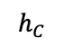








Computation of One GNN Layer
Key computation pattern: neighborhood aggregation
Aggregate operation: Each vertex aggregates the representations of its neighbors from the previous layer, i.e., $k−1$.
Combine operation: It updates a vertex’s representation by combining it with the aggregated neighbors’ representation.
Example: Graph Convolution Network (GCN)
$$h_{B}$$
B
B
$$l_{v}^{(k)}=Agg(\{h_{u}^{(k−1)}:u∈N\left(v\right)\})$$
$$h_{C}$$
C
A
$$f_{A}$$
C
A
$$=μ( )$$
$$h_{D}$$
$$h_{v}^{(k)}=Comb(\{h_{v}^{(k−1)},l_{v}^{(k)}\})$$
D
D
(𝑘−1)-th layer
(𝑘)-th layer
$$h_{v}^{\left(k\right)}=σ(\sum_{u∈N(v)}{\frac{1}{\sqrt{d_{v}∙d_{u}}}h_{u}^{(k−1)}W^{(k−1)}})$$
Notes:
Now, let’s dive into each GNN layer.
In each layer, the key computation pattern is neighborhood aggregation. It mainly includes two major operations.
The first one is aggregate operation. That means, each vertex aggregates the representations of its neighbors from the previous layer.
In formal, it is defined as this. As shown in this example, vertex A aggregates the neighbors, B, C, and D.
The second operation is Combine. It updates a vertex’s representation by combining it with the aggregated neighbors’ representation.
In formal, it is defined as this.
Different GNN algorithms usually define different aggregate and combine operations. Taking the popular Graph Convolution Network (GCN) as an example, the Aggregate and Combine operations are defined as this.

Slide 58


Challenge: Poor Understanding of GNN Performance
Different workloads and computation patterns:
Feature matrix
Neighborhood aggregation
What are their exact impacts on performance?
Contribution #1: A systematic study of GNN workloads on GPUs.
GPU: NVIDIA Tesla V100
Graph benchmark
NVIDIA Nsight Compute: an interactive kernel profiler for CUDA applications
Baseline GNN computation framework: deep graph library (DGL, Amazon)
 | |Vertex| | |Edge| | |Feature|
Reddit (RD) | 232 K | 114 M | 32
Ovcar-8h (OH) | 1.8 M | 3.9 M | 128
Notes:
It is obvious that GNN has different workloads and computation patterns than conventional graph algorithms.
However, what are their exact impacts on performance is not well understood by existing works.
With that, we first provide a systematic study of GNN workloads on GPUs.
We use an NVIDIA Tesla V100 GPU on these two graph benchmarks.
We use NVIDIA Nsight Compute to profile the performance,
And mainly use the GNN implementations from the Amazon’s deep graph library.

Slide 59
Observation #1: Atomic Operations
Atomic operations are used to avoid race conditions, used in the push model, edge-centric model, and GNNAdvisor [OSDI ’21]
Empirical study: GCN, implemented in push, edge-centric, GNNAdvisor, and pull model
Findings:
Using atomic operations increases memory atomic traffic (1.3 vs 1.3 vs 2.9 vs 0.0).
Using atomic operations waits more cycles for data (36.7 vs 80.1 vs 45.1 vs 26.5).
Key takeaway: Avoid using atomic operations.
Metrics | Push | Edge-centric | GNNAdvisor | Pull
Atomic memory traffic (GB) | 1.3 | 1.3 | 2.9 | 0.0
Stall for long scoreboard (cycle) | 36.7 | 80.1 | 45.1 | 26.5
Runtime (ms) | 3.3 | 2.8 | 10.4 | 1.8
Notes:
We get three interesting observations.
The first one is on Atomic Operations. Atomic operations are used to avoid race conditions, used in the push model, edge-centric model, and GNNAdvisor.
We perform an empirical study of GCN implemented in push, edge-centric, GNNAdvisor, and pull models.
These are the profiling results. Here, the pull model does not have atomic operations.
From the runtime, we can see the pull model is much faster.
Besides that, from the Atomic memory traffic metric, we can see using atomic operations increases memory atomic traffic, which is bad for the performance.
Also, from the Stall for long scoreboard metric, we can see using atomic operations will wait for more cycles.
To this end, the key takeaway is: Avoid using atomic operations.

Slide 60
Observation #2: Coalesced Memory Access
Coalesced memory access
The threads within the same warp access continuous memory addresses.
Example:
This warp requests 32 bytes data, all fall in the same cache line, leading to 100% bus utilization.
Uncoalesced memory access
The threads within the same warp access arbitrary memory addresses.
Example:
This warp requests 32 bytes, scattered into four different cache lines, leading to 25% bus utilization.
Addresses requested from a warp
…
0
32
64
96
128
Memory addresses
Coalesced memory access
Addresses requested from a warp
…
0
32
64
96
128
Memory addresses
Uncoalesced memory access
Notes:
Our second observation is about Coalesced memory access.
If the threads within the same warp access continuous memory addresses. That will lead to Coalesced memory access, which reduces memory requests, thus improves the performance.
In this example, all the Addresses requested from a warp fall in the same cache line, leading to 100% bus utilization. This is Coalesced memory access, which is the best case we are looking for.
The worst case is Uncoalesced memory access, which means The threads within the same warp accessing arbitrary memory addresses.
This example shows Uncoalesced memory access. The requested memory addresses are scattered into four different cache lines, leading to 25% bus utilization.

Slide 61
Observation #2: Coalesced Memory Access
How can we make memory access more coalesced?
Use more threads within a warp to process the same data (e.g., vertex).
Empirical study: GCN, implemented in one thread per vertex vs. half warp per vertex
Findings:
Coalesced memory access makes fewer memory requests (9.2 vs 2.1).
Accordingly, it reduces the # of cycles waiting for data (251.8 vs 75.2).
Key takeaway: Using more threads within a warp to process the same vertex.
Metrics | One thread | Half warp (16 threads)
Sector per request | 9.2 | 2.1
Stall for long scoreboard (cycle) | 251.8 | 75.2
Runtime (ms) | 434.9 | 15.9
Notes:
So, How can we make memory access more coalesced?
If we can use more threads within a warp to process the same data (e.g., vertex), the memory access will become more coalesced.
To test that, we also perform an Empirical study by running GCNs implemented in one thread per vertex and half warp per vertex.
These are the profiling results.
Obviously, Coalesced memory access makes fewer memory requests.
Accordingly, it reduces the # of cycles waiting for data. Together, one can see the runtime of half warp is much faster than one thread.
So, the key takeaway is, try to use more threads within a warp to process the same vertex.

Slide 62
Observation #3: Kernel Launch
The GNN computation can be implemented with different numbers of GPU kernels.
Empirical study: Graph attention network (GAT), implemented in DGL, three kernels, and one kernel
Findings
Using fewer kernels can avoid kernel launch overhead and thus reduce DRAM usage.
It can also reduce unnecessary memory traffic.
Key takeaway: Using as fewer kernels as possible.
Metrics | DGL | Three kernels | One kernel
GPU kernel launch | 18 | 3 | 1
Launch overhead (ms) | 20 | 3.69 | 0.5
DRAM usage (GB) | 10 | 2.8 | 1.5
Memory traffics (GB) | 35.9 | 19.5 | 4.8
Runtime (ms) | 122 | 74.6 | 16.1
Notes:
Our third observation is on Kernel Launch.
The GNN computation can be implemented with different numbers of GPU kernels.
To study this, we run graph attention network (GAT) implemented in DGL, three kernels, and one kernel.
Here are the profiling results.
Basically, we can find that Using fewer kernels can avoid kernel launch overhead and thus reduce DRAM usage.
It can also reduce unnecessary memory traffic.
So, the Key takeaway is Using as fewer kernels as possible.

Slide 63
Contribution #1: Understanding GNN Workloads on GPUs
Observation #1: Avoid using atomic operations.
Observation #2: Use more threads within a warp to process the same vertex.
Observation #3: Use as fewer kernels as possible.
Notes:
In summary, we make these three observations.
We should Avoid using atomic operations.
We should use more threads within a warp to process the same vertex.
We should use as fewer kernels as possible.

Slide 64



Contribution #2: TLPGNN: Two-level Parallelism
First level of parallelism
vertex-warp: Mapping each vertex to all the threads in a warp
Benefits
No atomic operations: the workloads associated with each vertex are independent from each other.
No branch divergence: threads in one warp following the same control path.
…
$$v0$$
…
warp₀
…
$$v1$$
…
warp₁
…
…
$$vn$$
…
warp_{n}
Notes:
Motivated by that, we design a new computation model for GNNs. That is, a two-level parallelism GNN computation model, named TLPGNN.
In the first level, we are mapping each vertex to all the threads in a warp.
That is, as shown in this example, all the 32 threads in one warp will be assigned to compute one vertex.
The benefits of doing this are two-fold.
First, there is No atomic operations because the workloads associated with each vertex are independent from each other.
Second, there is No branch divergence because threads in one warp following the same control path.

Slide 65

Contribution #2: TLPGNN: Two-level Parallelism
Second level of parallelism
feature-thread: Mapping each feature dimension of a vertex to a thread in the warp.
Benefits
No atomic operations: different threads work on different dimensions, no conflicts.
Coalesced memory access: adjacent threads access adjacent memory addresses.
Moving
direction
$$v$$
Notes:
In the Second level,
We map each feature dimension of a vertex to a thread in the warp,
as shown in this example.
The benefits of doing this are also two-fold.
First, there is No atomic operations, because different threads work on different dimensions, no conflicts.
Second, the memory access are coalesced because the adjacent threads access adjacent memory addresses.
Such a two-level parallelism design also aligns with the hierarchical architecture of GPU.

Slide 66
Contribution #3: Optimizations
Dynamic workload assignment
Dynamically assign the workload of each vertex to a warp.
Benefit: avoid workload imbalance.
Kernel fusion
Using one kernel to implement GNNs.
Benefit: avoid intermediate data and unnecessary data load and store to global memory.
Register caching
Using registers to store the frequently accessed index boundary and intermediate resulting feature.
Benefit: reduce unnecessary global memory requests.
Notes:
We also design a few other optimizations,
Including Dynamic workload assignment,
Kernel fusion
And Register caching

Slide 67
Experimental Setup
Implementation
3,000+ lines of code in CUDA and Python.
GNN models
GCN, GIN, GraphSage, and GAT.
Environments
Nvidia V100 32GB
Cuda 11.1
Centos 8
Graph (Abbr.) | |Vertex| | |Edge| | Avg. degree
Citeseer (CS) | 3.3K | 9.2K | 2.7
Cora (CR) | 2.7K | 10.5K | 3.8
Pubmed (PD) | 19.7K | 88.6K | 4.5
Ogbn-arxiv (OA) | 169K | 1.1M | 6.5
PPI (PI) | 56K | 1.6M | 28.5
DD (DD) | 334K | 1.6M | 4.9
Ovcar-8h(OH) | 1.8M | 3.9M | 2.2
Collab (CL) | 372K | 24.9M | 66.9
Ogbn-protein (ON) | 132K | 79M | 607
Reddit (RD) | 232K | 114M | 491
Ogbn-product (OT) | 2.4M | 123.7M | 51.5
Notes:
Here are our experiment details, and the tested graphs.

Slide 68
Speedup of TLPGNN over Compared Methods
The higher,
the better of ours
Speedup = Runtime of others / TLPGNN
Overall speedups:
7.7x over GNNAdvisor [OSDI ’21]
5.6x over DGL [Amazon]
3.3x over FeatGraph [SC ’20]
Notes:
We use speedup as the comparison metric, which is defined as the Runtime of others over TLPGNN.
Overall, our TLPGNN is much faster than the three compared methods.

Slide 69

Tango: Re-Thinking Quantization for GNN Training on GPUs
Quantization is a primary approach to accelerating various DNN and GNN models as it can reduce both computation and data access.
E.g,, computing 8-bit integers on tensor core has 2x and 32x more throughput than 16-bit and 32-bit floating-point.
Challenge: Quantization errors (caused by fewer bits) could prevent the model from achieving the desired accuracy.
Solution: Tango, the first GPU-based quantized GNN training system that both maintains the model accuracy and reduces computation time.
Performance:
1.2x and 1.5x speedup over GCN and GAT from DGL [Amazon]
2.9X and 4.1x speedup over GCN and GAT from EXACT [ICLR ’22]
Notes:
Besides TLPGNN, we have another work focusing on GNN training in this year’s SC.

Slide 70

PeeK: A Prune-Centric Approach for K Shortest Path
K shortest path (KSP) algorithm aims to find the top-K shortest paths from the source vertex s to the target vertex t.
Key observation: Top-K shortest paths only cover an extremely small portion of the original graph, even for very large K values.
Comparison with state-of-the-art:
Serial: 2.2x and 3.1x speedup for K = 8, 128
Parallel (32 threads): 5x and 29x speedup for K = 8, 128
Notes:
For conventional graph algorithms, we got one paper on top-k shortest paths in SC this year.

Slide 71
Aquila: Accelerating Different Connectivity Algorithms
Directed
Strongly connected component (SCC), 1.1x
Weakly connected component (WCC), 6x
Undirected
Connected component (CC), 6x
Biconnected component (BiCC), 21x
Articulation point (AP), 2.3x
Bridgeless connected component (BgCC), 23x
Bridge, 12x
HPDC 2020
Notes:
We also design algorithms for various connectivity algorithms.

Slide 72

iSpan: Parallel SCC Computation with Spanning Tree
Strongly Connected Component (SCC)
In a directed graph, an SCC is a maximal subset of the vertices that every vertex has at least one directed path to all the others.
SCC computation aims to find all the SCCs in a directed graph.
23
10
14
9
0
7
22
17
11
8
1
2
21
16
15
6
4
5
20
19
18
13
12
3
Notes:
Especially for strongly connected component.

Slide 73
Summary of HPC for Graph Algorithm
Efficient GNN computation systems on GPUs
TLPGNN: two-level parallelism [HPDC ’22]
Tango: quantization-based GNN computation [SC ’23]
State-of-the-art parallel graph algorithms design
Top-K shortest path [SC ’23]
Various connectivity algorithms [SC ’18, HPDC ’22]
(W)CC, SCC, BiCC, BgCC, AP, and Bridge
NSF CISE Small Core Collaborative: LEGAS: Learning Evolving Graphs At Scale (Lead-PI, $600k)
Notes:
In summary, for Efficient GNN computation systems on GPUs, we have designed TLPGNN, and Tango.
For conventional graph algorithms, we have designed the state-of-the-art parallel algorithms for top-k shortest path and various connectivity algorithms.

